Slide 1
Using Health Data Australia for Secondary Data Research
DATE
NAME
ROLE
Notes:
Introduce myself and HeSANDA/HDA involvement

Slide 2
Notes:
But first I would like to acknowledge these gorgeous views of the lakes, which is part of an Aboriginal cultural landscape in the traditional Country of the Bunurong People.
I acknowledge and respect the deep and continuing connection that Bunurong Traditional Owners have to these lands and waters and recognise their ongoing role in caring for Country – which we can all appreciate.

Slide 3

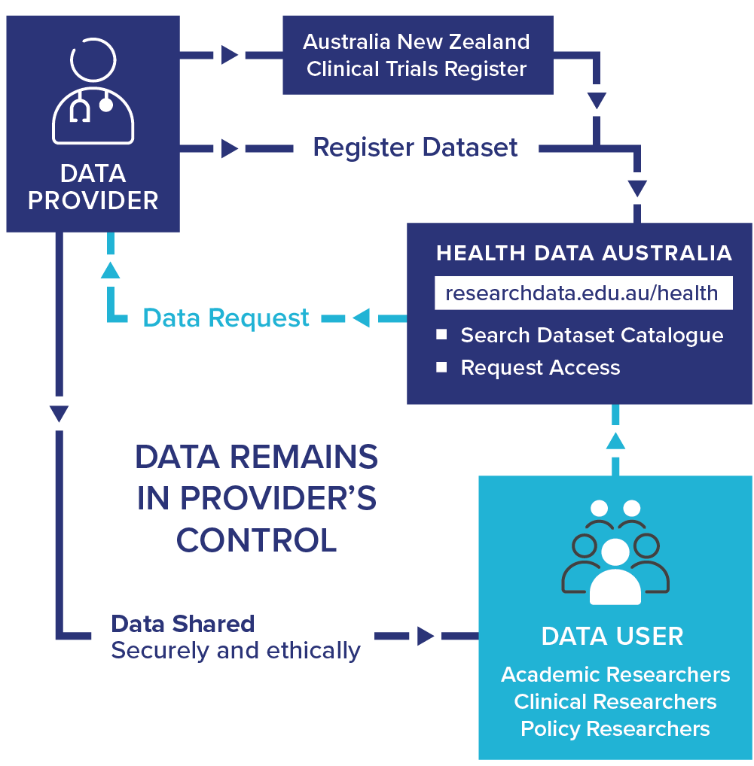
HeSANDA
Health Studies Australian National Data Asset
Health Data Australia (HDA)
Discover and request clinical trial data from around Australia
researchdata.edu.au/health/
Notes:
EXAMPLE: Health Studies Australian National Data Asset (HeSANDA)
The People RDC builds on our experience creating national digital research infrastructure for health and medical researchers.
One example is, HeSANDA, our Health Studies National Data Asset, which is a national research infrastructure that is enabling researchers to share, access and reuse health research data to increase research impact and integrity.
The first phase of HeSANDA has worked alongside the health research community to support the sharing of clinical trials data.
The program includes 91 collaborators from 72 organisations, including 18 universities, 10 medical research institutes, 19 health service operators and 16 clinical trials networks.
Potential Benefits of HeSANDA include:
Collaboration
New health and medical research
Reduce costs, duplication, saves time
Extends the life of initial research
Contributes to data integrity
The next phase of the program has started already to expand the coverage beyond clinical trials data to data from observational studies such as cohort studies, and will integrate technologies to enable secure analysis of data.
https://ardc.edu.au/program/health-studies-australian-national-data-asset/

Slide 4
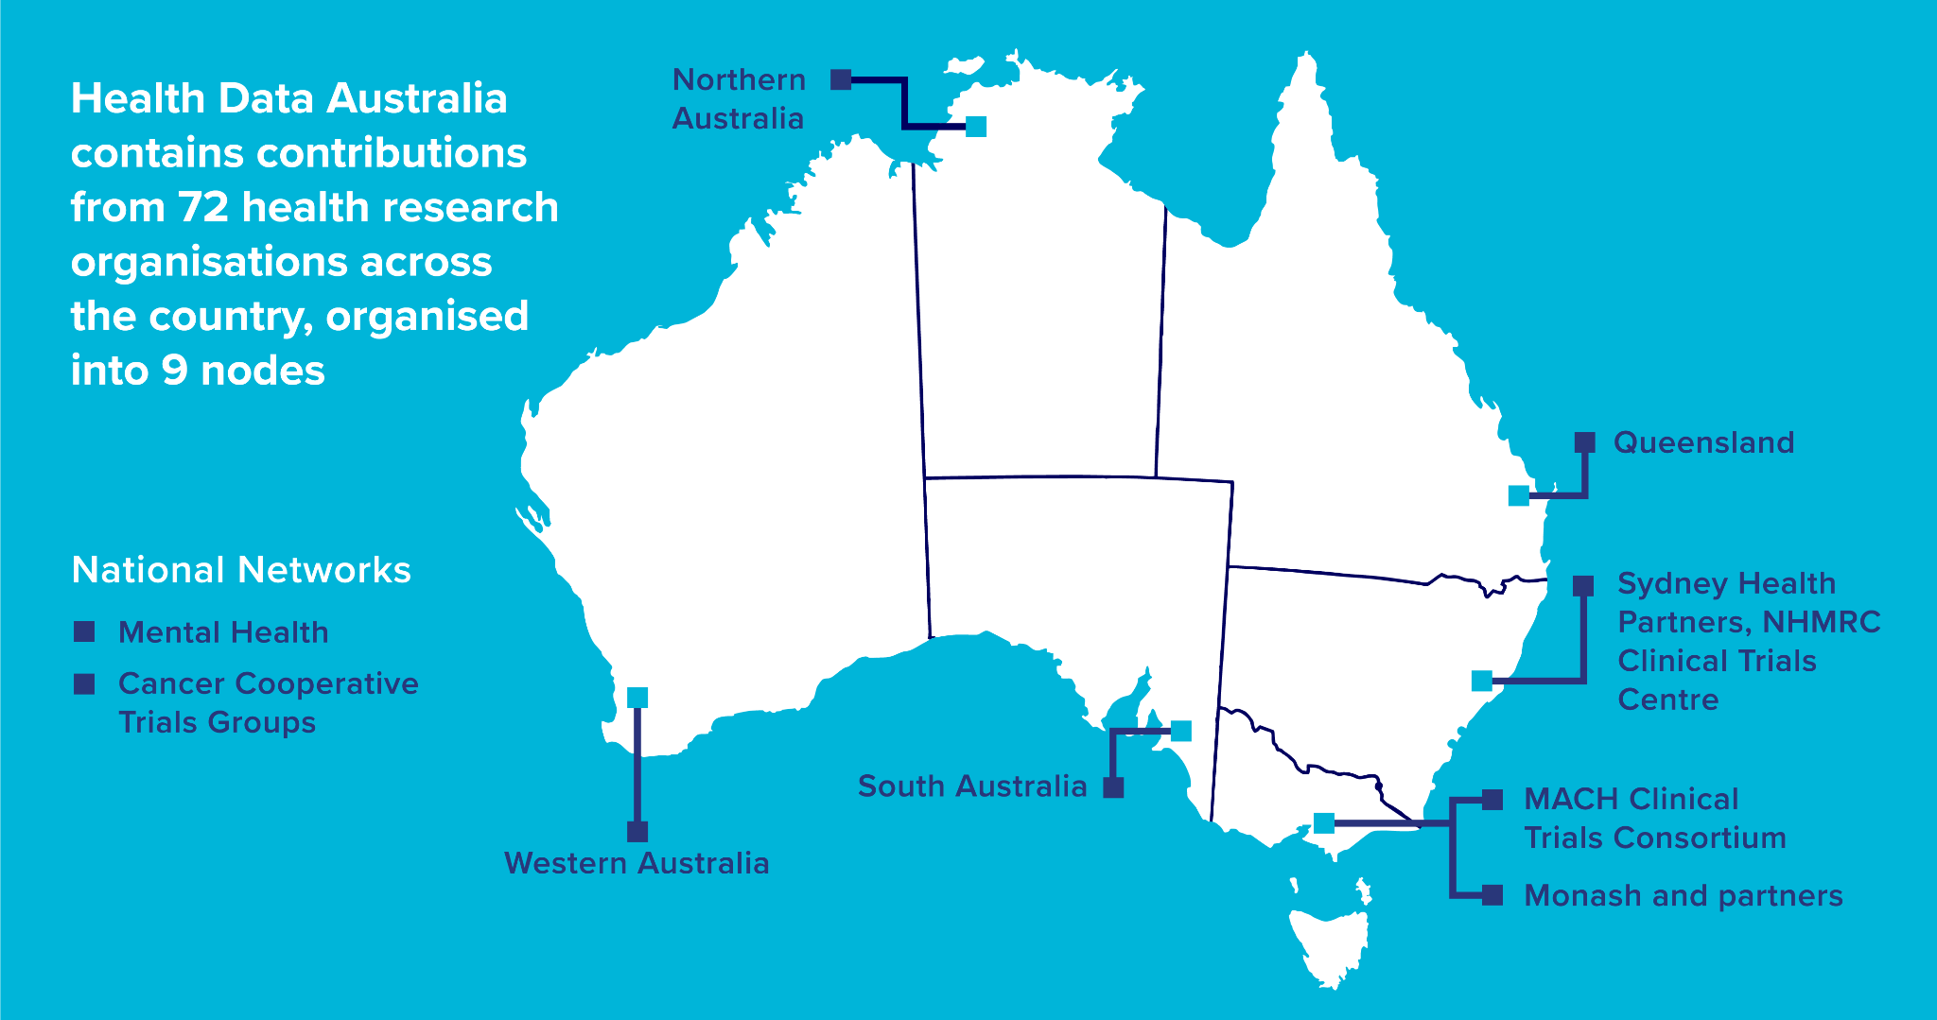
Notes:
72 organisations are leading the way and have created a national data sharing infrastructure network for Australia.
They’re grouped into 9 nodes:
7 of our nodes provide regional coverage in most states and territories
And the other 2 nodes have specialisations - 1 in cancer trials - and 1 in mental health trials
We’re working together as a national community of trials to agree on those standards.
And then each Node is working with their partners to implement the standards in a way that works best for their organisations.

Slide 5
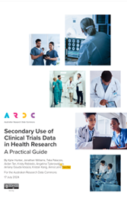
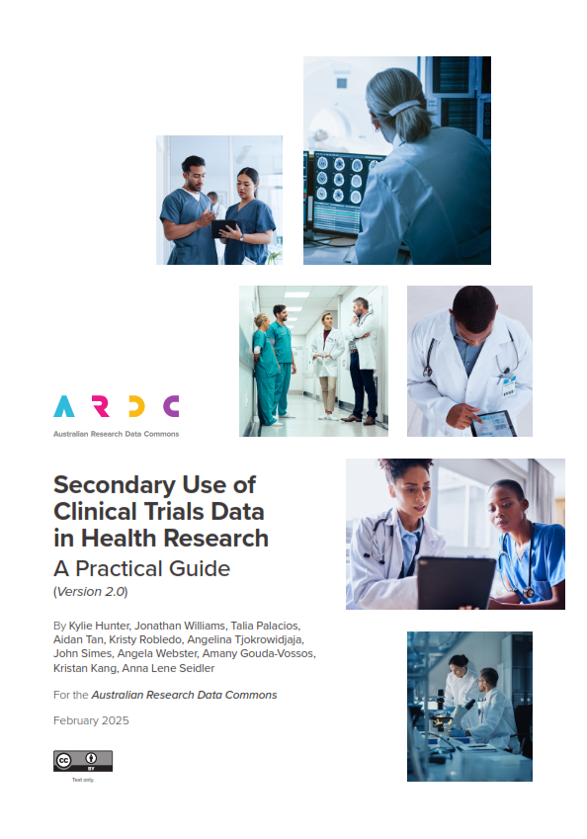
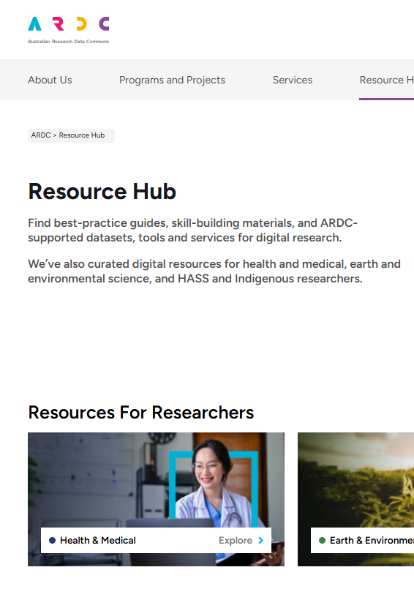
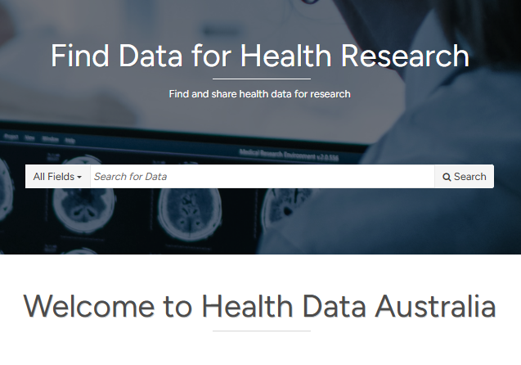
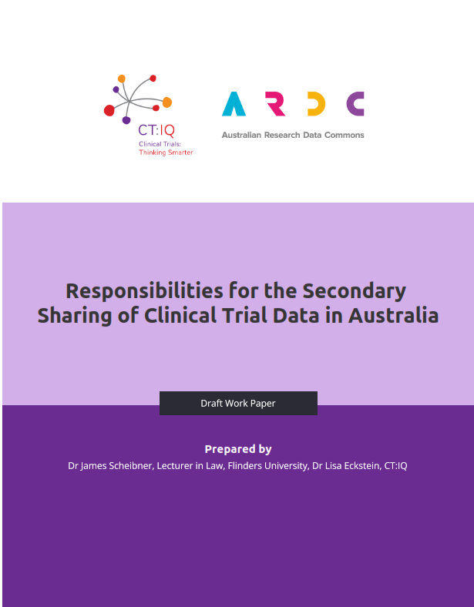
Secondary Data Research - ARDC products and services
Health Data Australia
Clinical research data sharing frameworks
Secondary data use materials

Slide 6
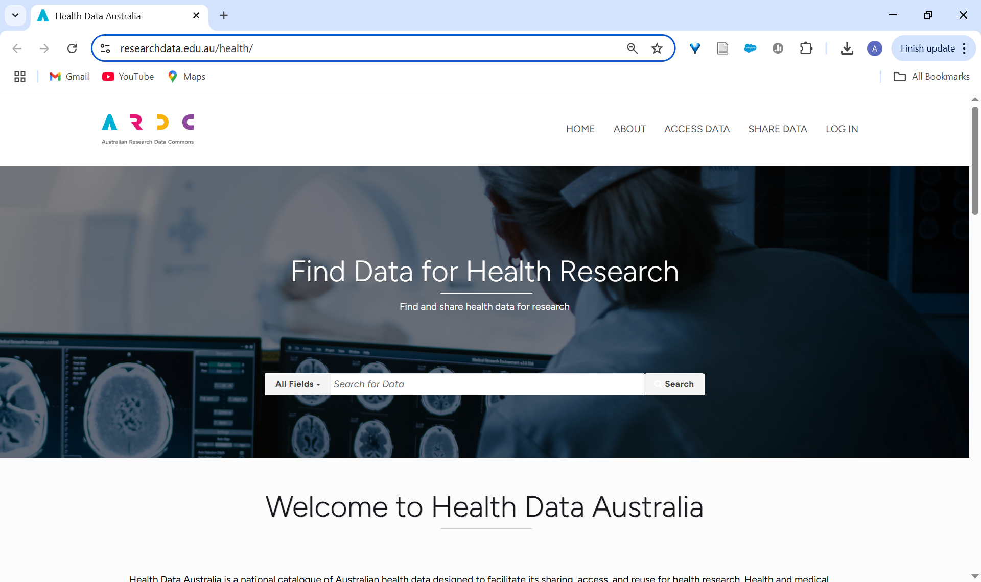

Health Data Australia
3 things to keep in mind…
HDA contains only descriptions of data (metadata), not the data itself
The data is always in control of the data custodians/ data provider
The platform is relatively new
      Scan to visit
      Health Data Australia

Slide 7
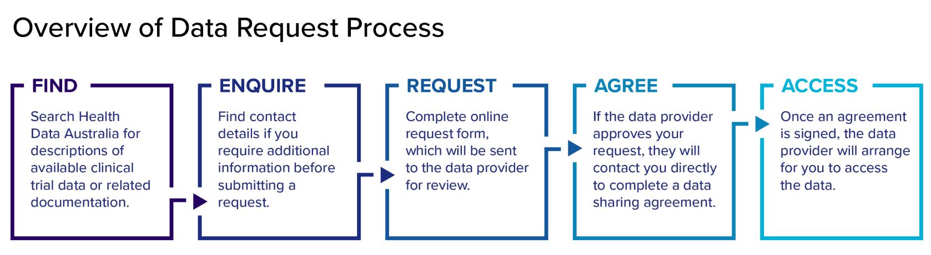

Slide 8
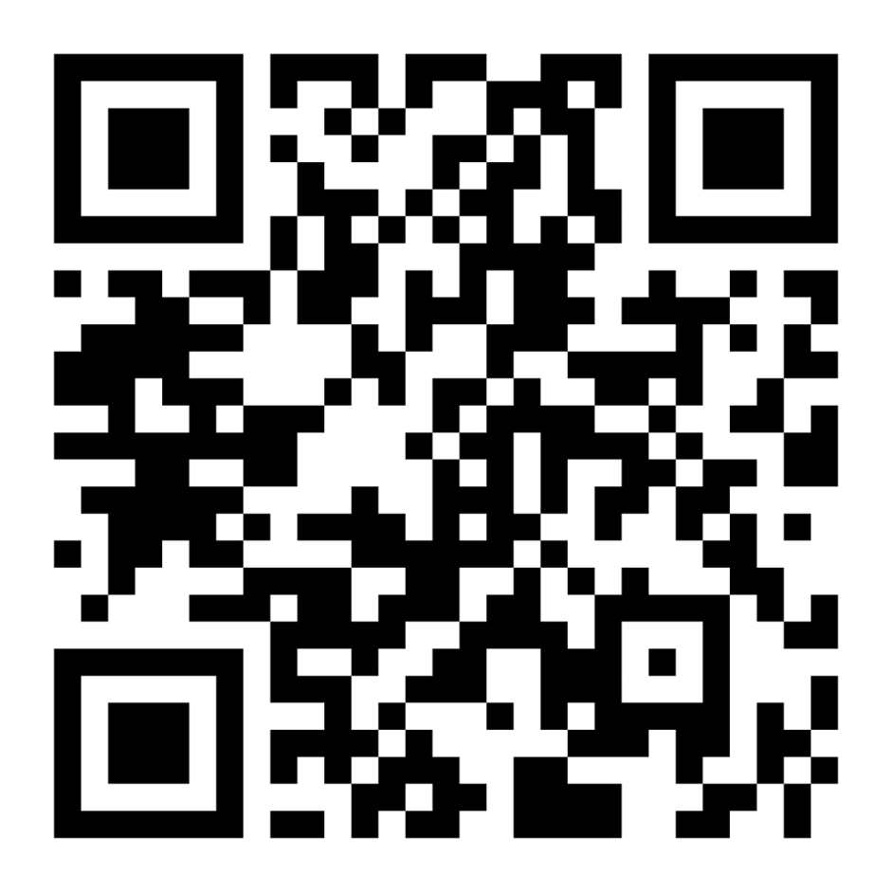
Health Data Australia
researchdata.edu.au/health/
      Scan to visit
      Health Data Australia
Notes:
LIVE Health Data Australia Demonstration:
Click the link and give the audience a run through of the HDA platform (see below for an outline if you need it).
You can also encourage the audience to go to the platform for themselves.
Suggested structure of demonstration:
Landing page
Four Tabs on the right corner - explain what they are and when they will need them
Enter search term in tab or click on the ‘search tab’ to access and showcase the catalogue
Describe the features of the catalogue, including the filters on the left
Click on a data set
Describe the:
Data set description
Relationship graph
Source study information (i.e. summary, details. And data sharing)
Scroll up, and explain “Access to the Data” and “Save to myHDA” (and that a myHDA account is automatically created when you log into the system with their AAF)
Click on “Access to the data”
Explain what an AAF is, and that a myHDA account is automatically created when you log into the system with their AAF
Go through the data request descriptors and what is required (you may also do this using a teaching scenario <LINK>):
Dataset requested
Applicant details
Project administrator
Project design
Project outputs
Ethics

Slide 9
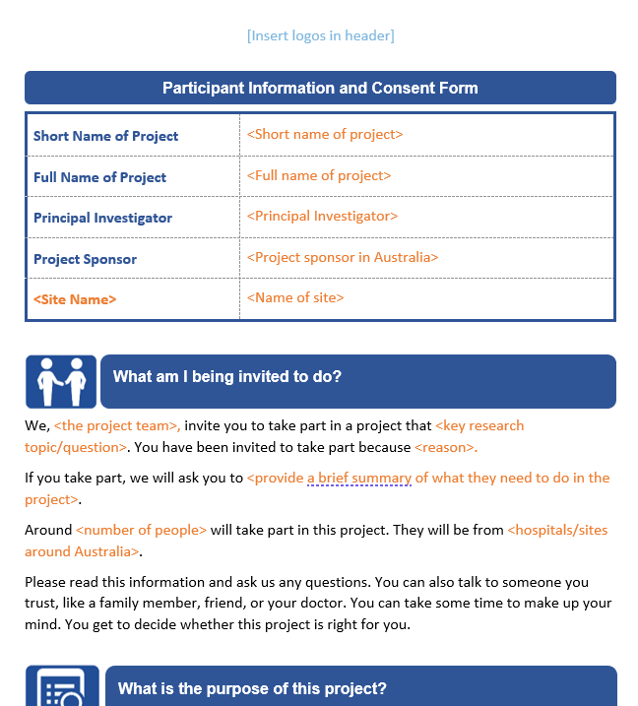
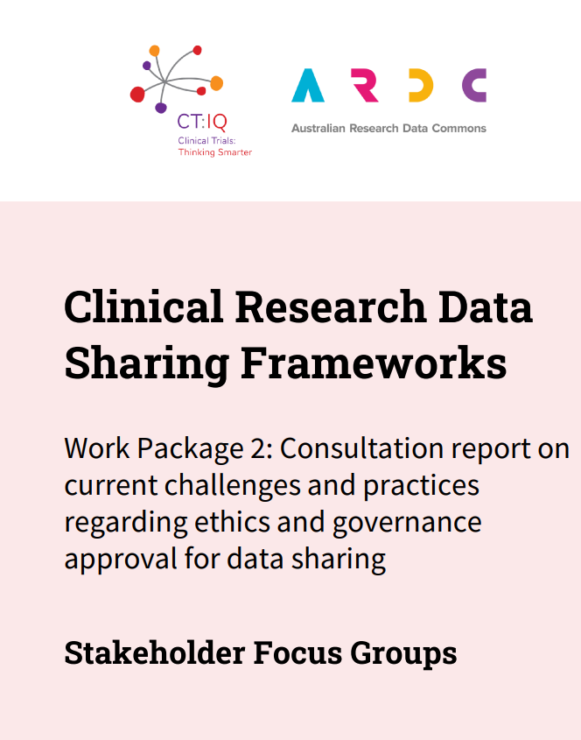
Clinical Research Data Sharing Frameworks
Collaboration with CT:IQ
Improve efficiency & quality of clinical research data sharing decisions by Australian researchers, HRECs, research governance offices & institutions.

Slide 10
Clinical Research Data Sharing Frameworks
InFORMed Project - PICFs Template
Governance framework
Consultation report
Upcoming
HREC benchmarking
Resource toolkit

Slide 11
Secondary Data Use
Collaboration with NextGen Team, NHMRC Clinical Trials Centre (based at USYD) and Cochrane.
Aims to define and communicate the scientific value and use cases of secondary research using clinical trials data.

Slide 12
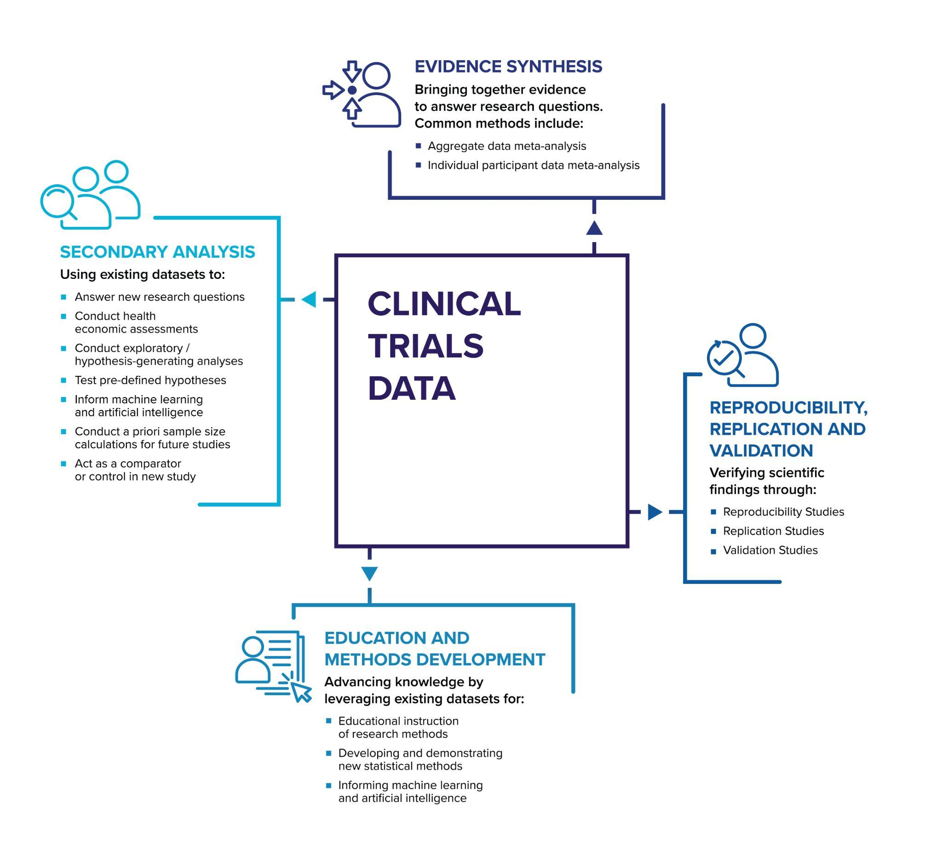

Guide Book
Types of Secondary Research Using Clinical Trials Data
Notes:
Types of Secondary Research Using Clinical Trials Data

Slide 13
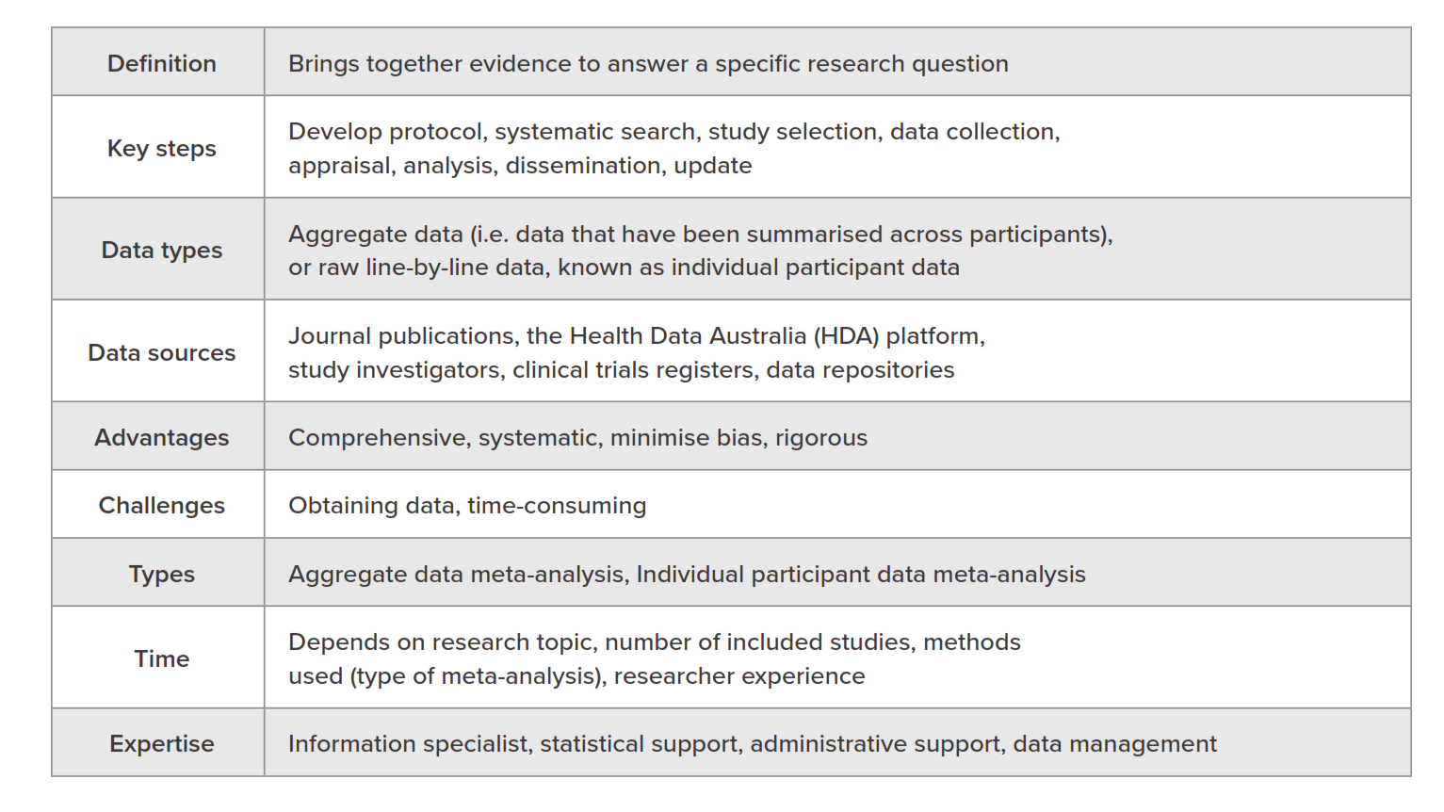
Evidence Synthesis

Slide 14
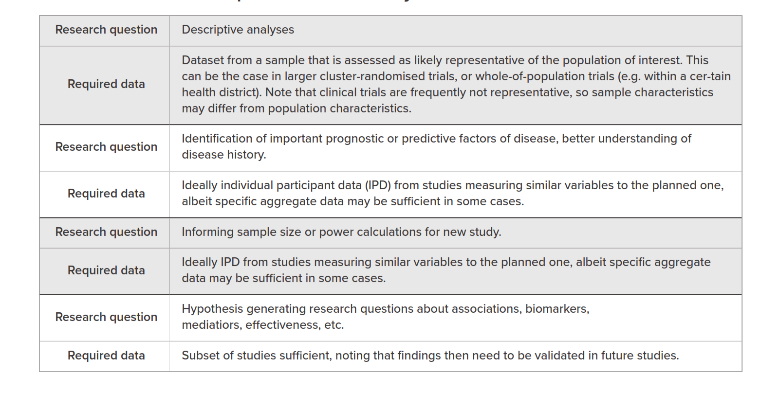
Evidence Synthesis - Examples

Slide 15

Evidence Synthesis- Case Study
Sharing Secondary Data to Give Babies Born Too Early a Better Chance of Survival - Dr Sol Libesman

Slide 16
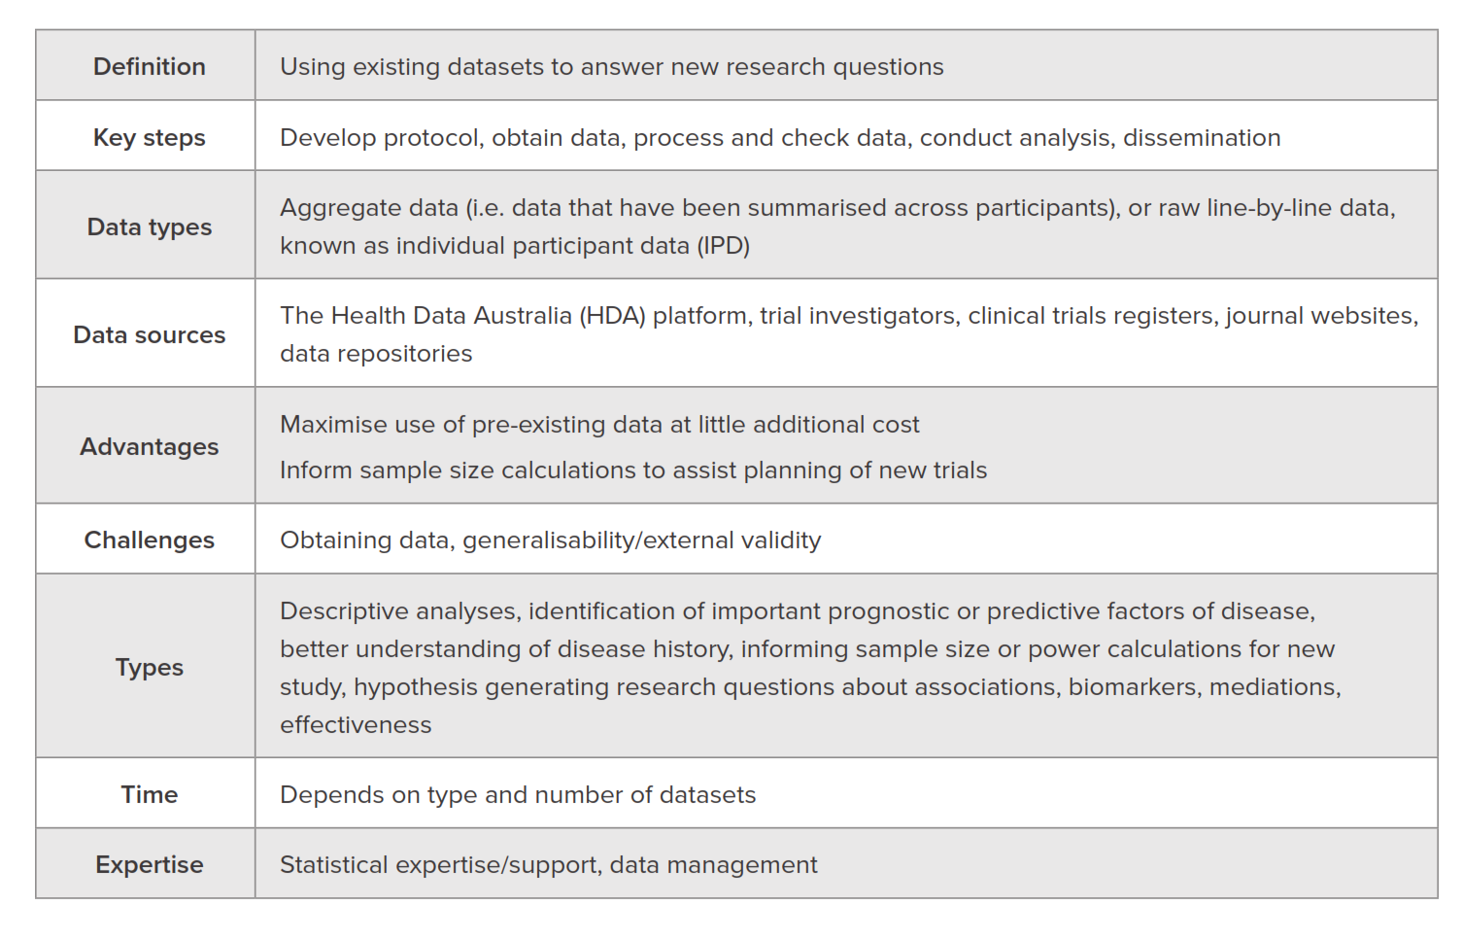
Secondary Analysis

Slide 17
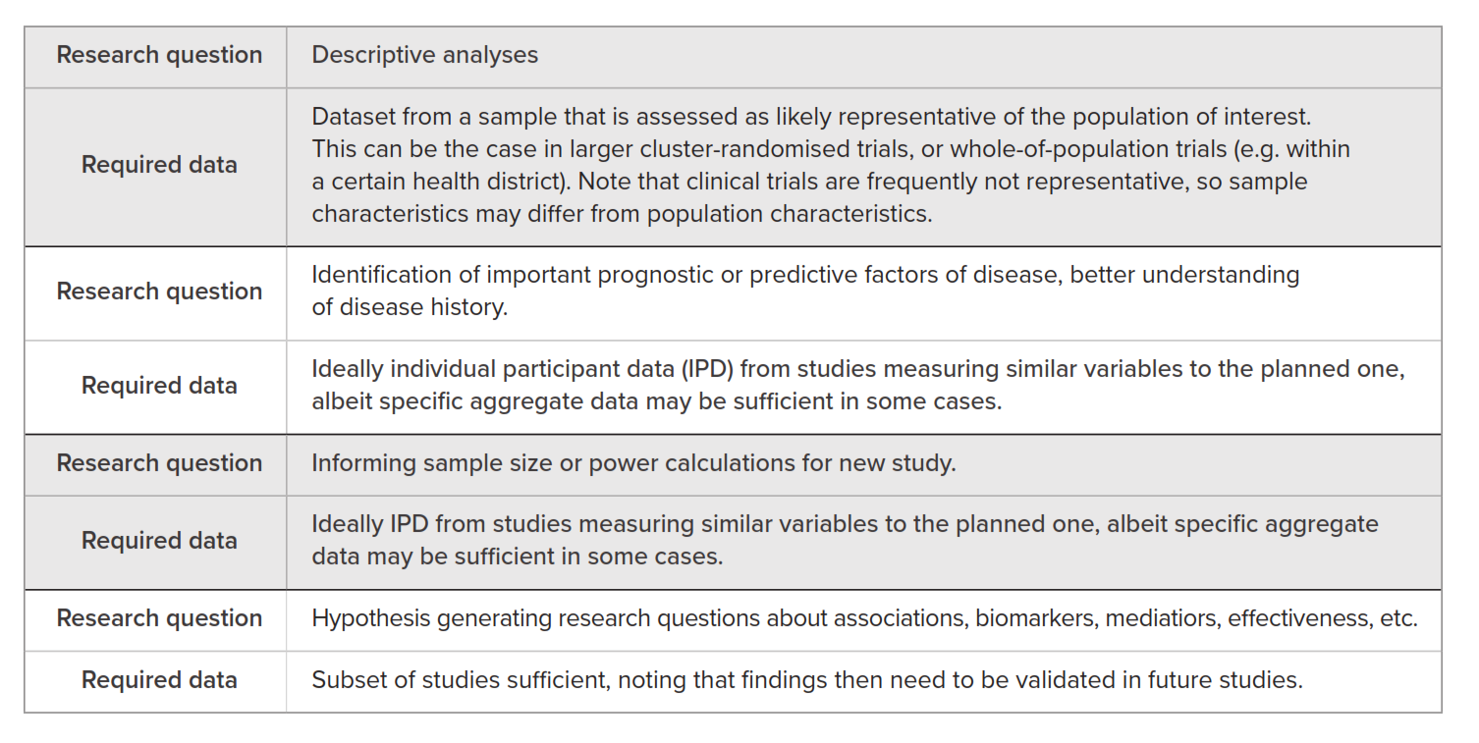
Secondary Analysis - Examples

Slide 18

Secondary Analysis - Case Study
Using existing trial datasets to determine the clinical accuracy of tumour marker blood test CA-125 versus CT imaging criteria to detect cancer progression in patients with ovarian cancer - Dr Angelina Tjokrowidjaja

Slide 19
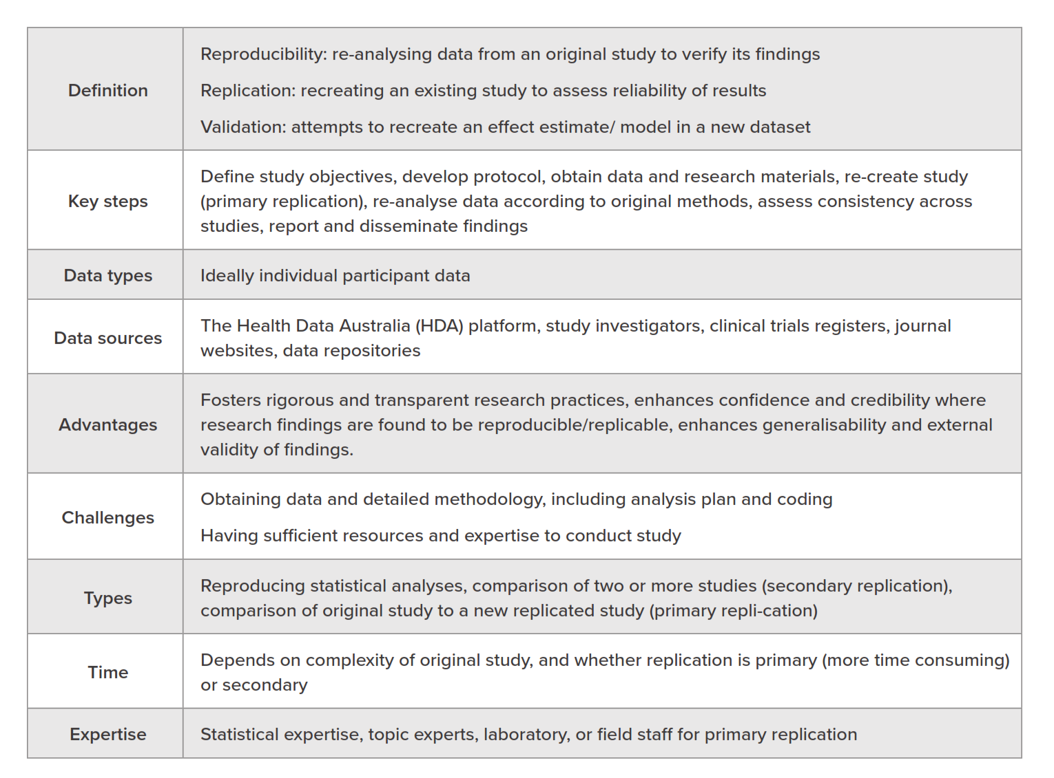
Reproducibility, Replication and Validation

Slide 20
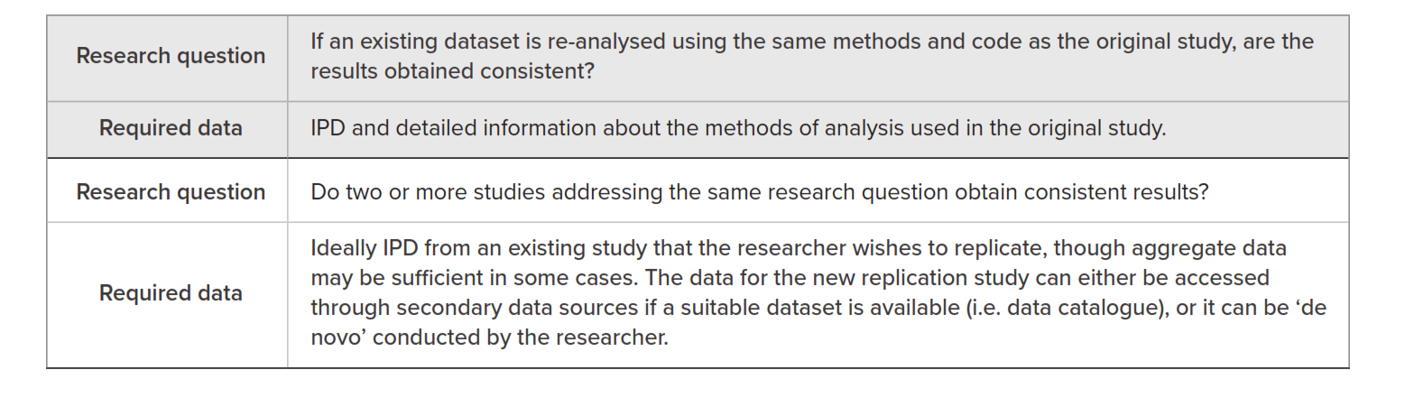
Reproducibility, Replication and Validation With Secondary Data - Examples

Slide 21
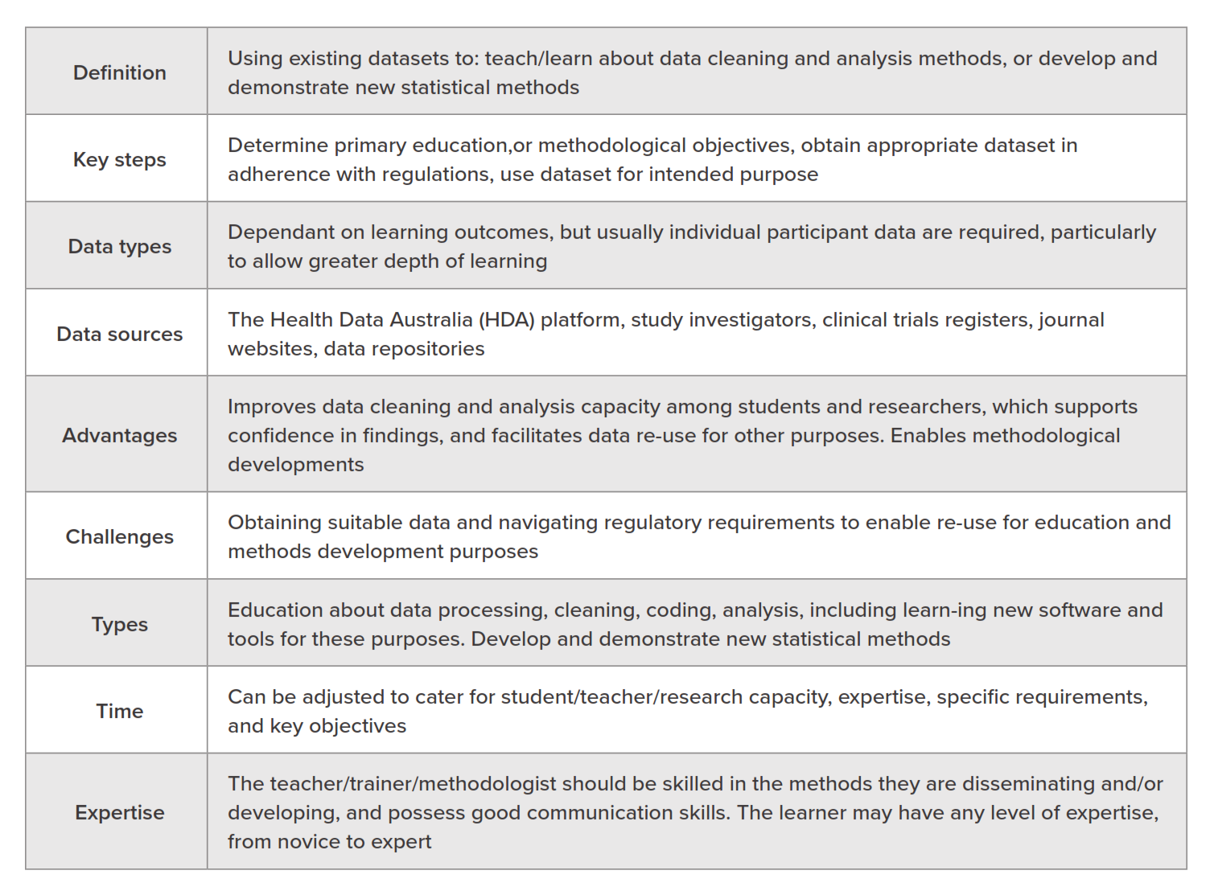
Education and Methods Development

Slide 22
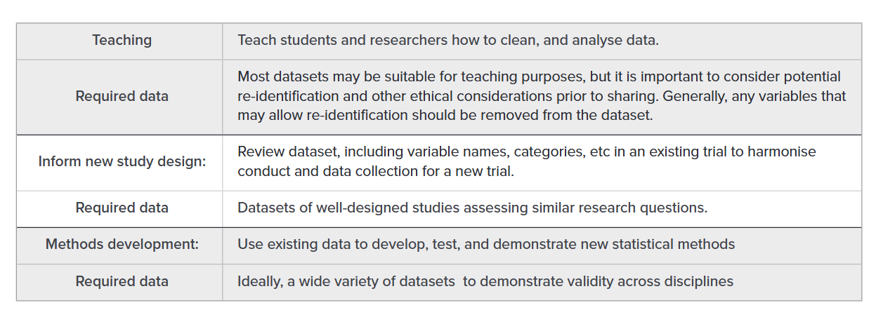
Education and Methods Development - Examples

Slide 23

Education and Methods development - Case Study
Sharing secondary data to develop, test, and demonstrate new statistical methods - Dr. Kristy Robledo,

Slide 24

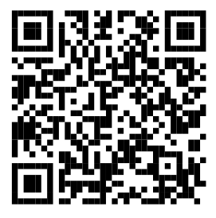
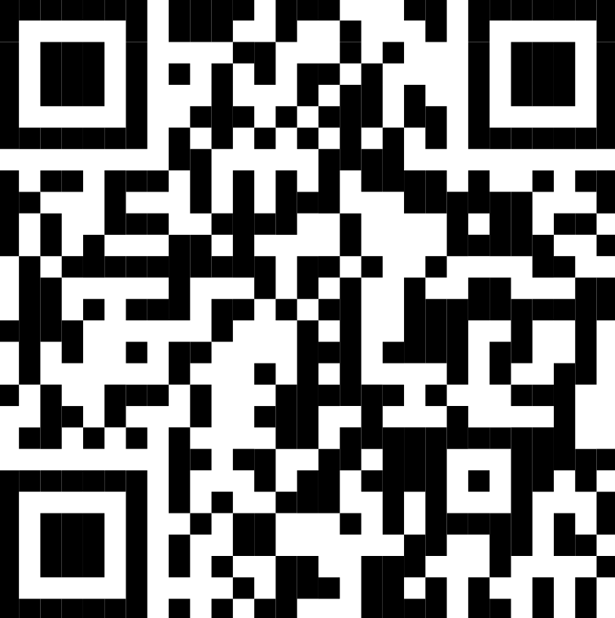
Get Involved
Learn more about and register
your interest in the People
Research Data Commons.
Explore the HDA catalogue
Consider contributing to HDA
Read “Secondary use of clinical trials data in health research: A Practical Guide”
Sign up for ARDC newsletter, People RDC Register Interest for future news, resources, and free events!
PeopleRDC
https://ardc.edu.au/people-research-data-commons/
Subscribe to our newsletter
ardc.edu.au/subscribe
Notes:
RESOURCES FOR HEALTH AND MEDICAL RESEARCHERS
The People RDC builds on the ARDC’s experience creating national digital research infrastructure for health and medical science researchers.
Find existing resources for researchers and get involved with the People RDC at https://bit.ly/ARDCPeople >
Image credit
Gorodenkoff - 236237514 / adobestock.com

Slide 25
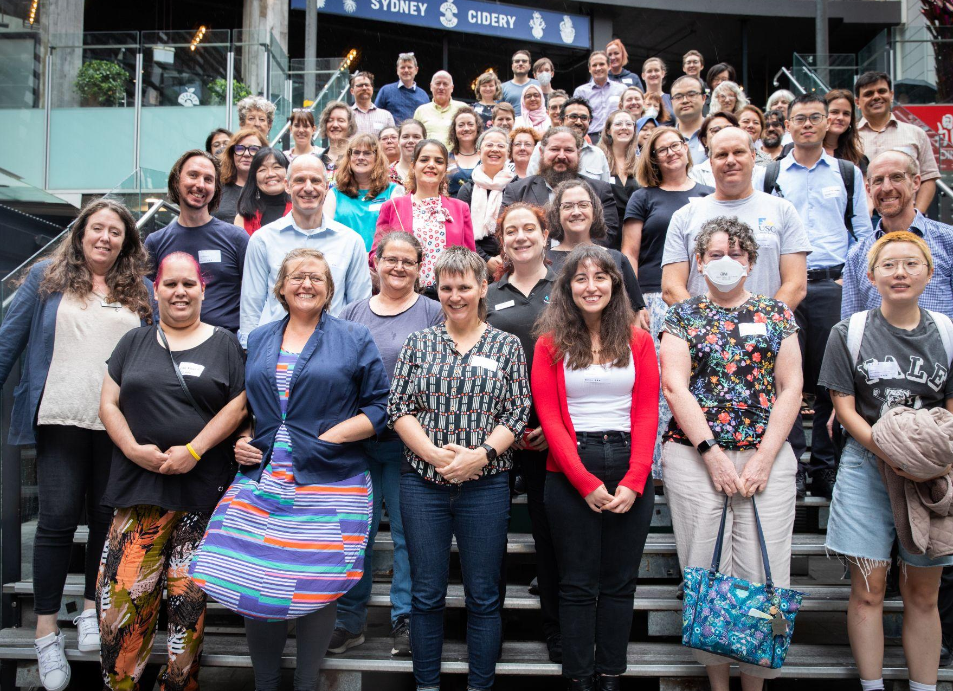

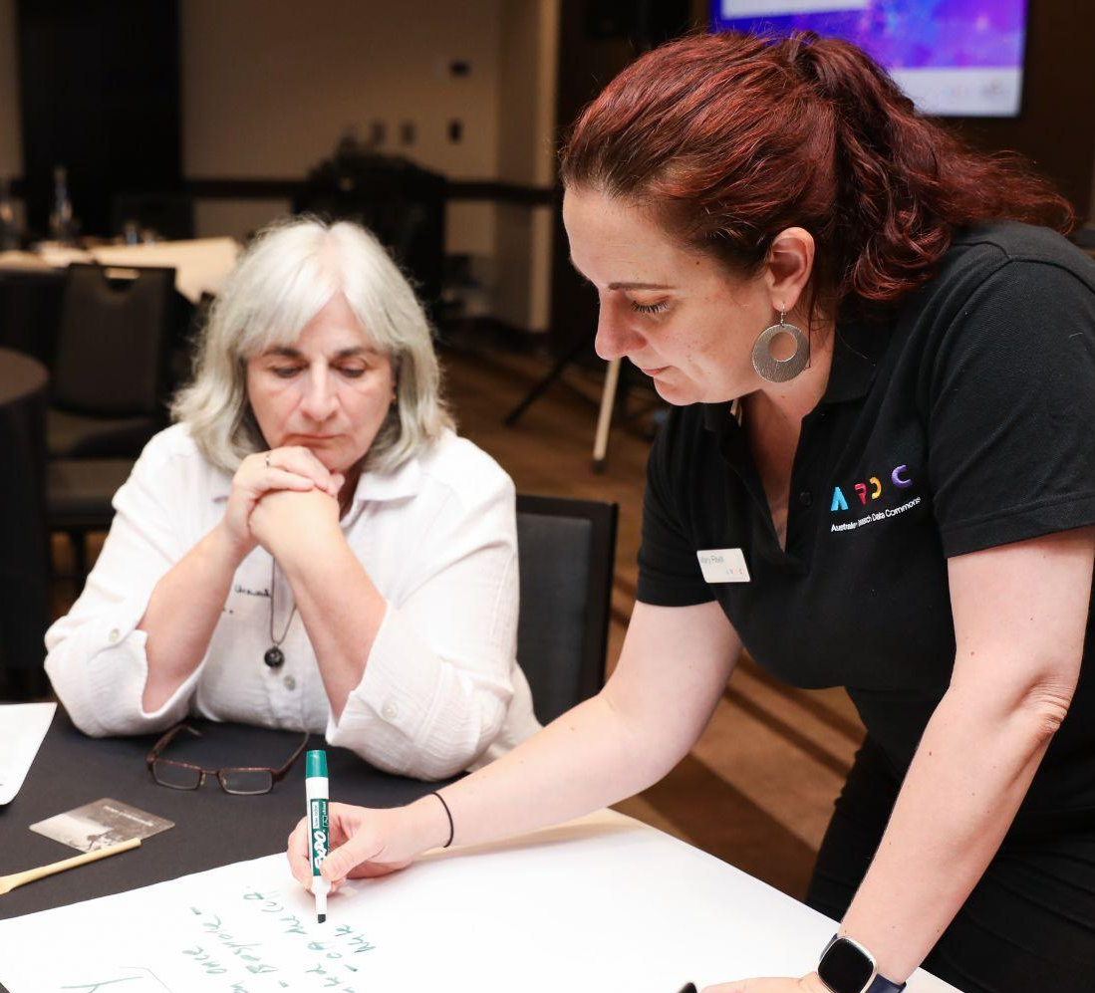
Contact us
HeSANDA Management Team
hesanda@ardc.edu.au
Any general questions
contact@ardc.edu.au

